Slide 1
HKCEM JCM OSCE March 2016
KWH

Slide 2
Case 1
Left Acromioclavicular joint dislocation.
Type III AC joint injury: clavicle elevated above the superior border of the acromion but coracoclavicular distance is less than twice normal (i.e. <25mm)
Left Acromioclavicular ligament and coracoclavicular (conoid and trapezoid lig) ligament would be torn.
Current evidence does not support surgical intervention on Type III injuries as a general rule. Patients who are particularly thin, require great range of motion or do heavy lifting may benefit from operative repair.

Slide 3
Case 2
Dx is retinal detachment
3 basic mechanisms:
A hole, tear, or break in the neuronal layer allowing fluid from the vitreous cavity to seep in between and separate retina and the underlying retinal pigment epithelium(ie, rhegmatogenous RD)
Traction from inflammatory or vascular fibrous membranes on the surface of the retina, which tether to the vitreous
Exudation of material into the subretinal space from retinal vessels such as in hypertension, central retinal venous occlusion, vasculitis, or papilledema
Hx: flashing lights followed by large number of floaters. Over time, visual field loss occurs which could be irregular or curtain-like.
Urgent consultation with ophthalmologist, limit strenuous activity, retinal repair, treat underlying causes.

Slide 4
Case 3
i) sinus tachycardia; ii) widened QRS; iii) prolonged QTc
Dothiepin – TCA
Cardiotoxic effect result from the blockage of the fast inward sodium channels on the myocardial membrane.
Sodium bicarbonate

Slide 5
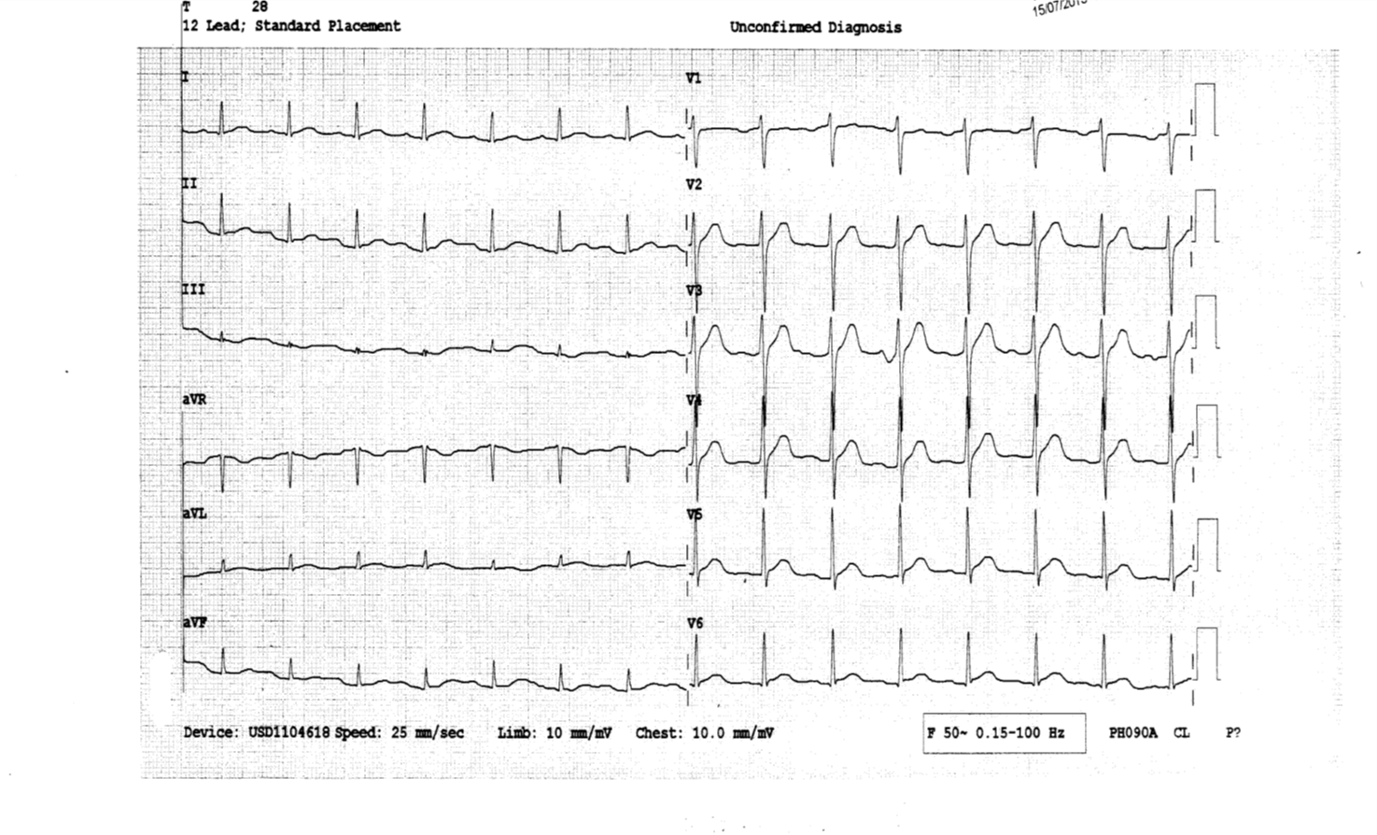

Slide 6
Case 4
Distal radius fracture extending into the radiocarpal joint with volar subluxation of radiocarpal joint.
Volar Barton fracture
Majority need ORIF

Slide 7
Case 5
Fournier’s gangrene
Alcoholism, DM, morbid obesity, IV drug user, HIV infection.
Broad-spectrum antibiotics and wide surgical debridement.

